Slide 1
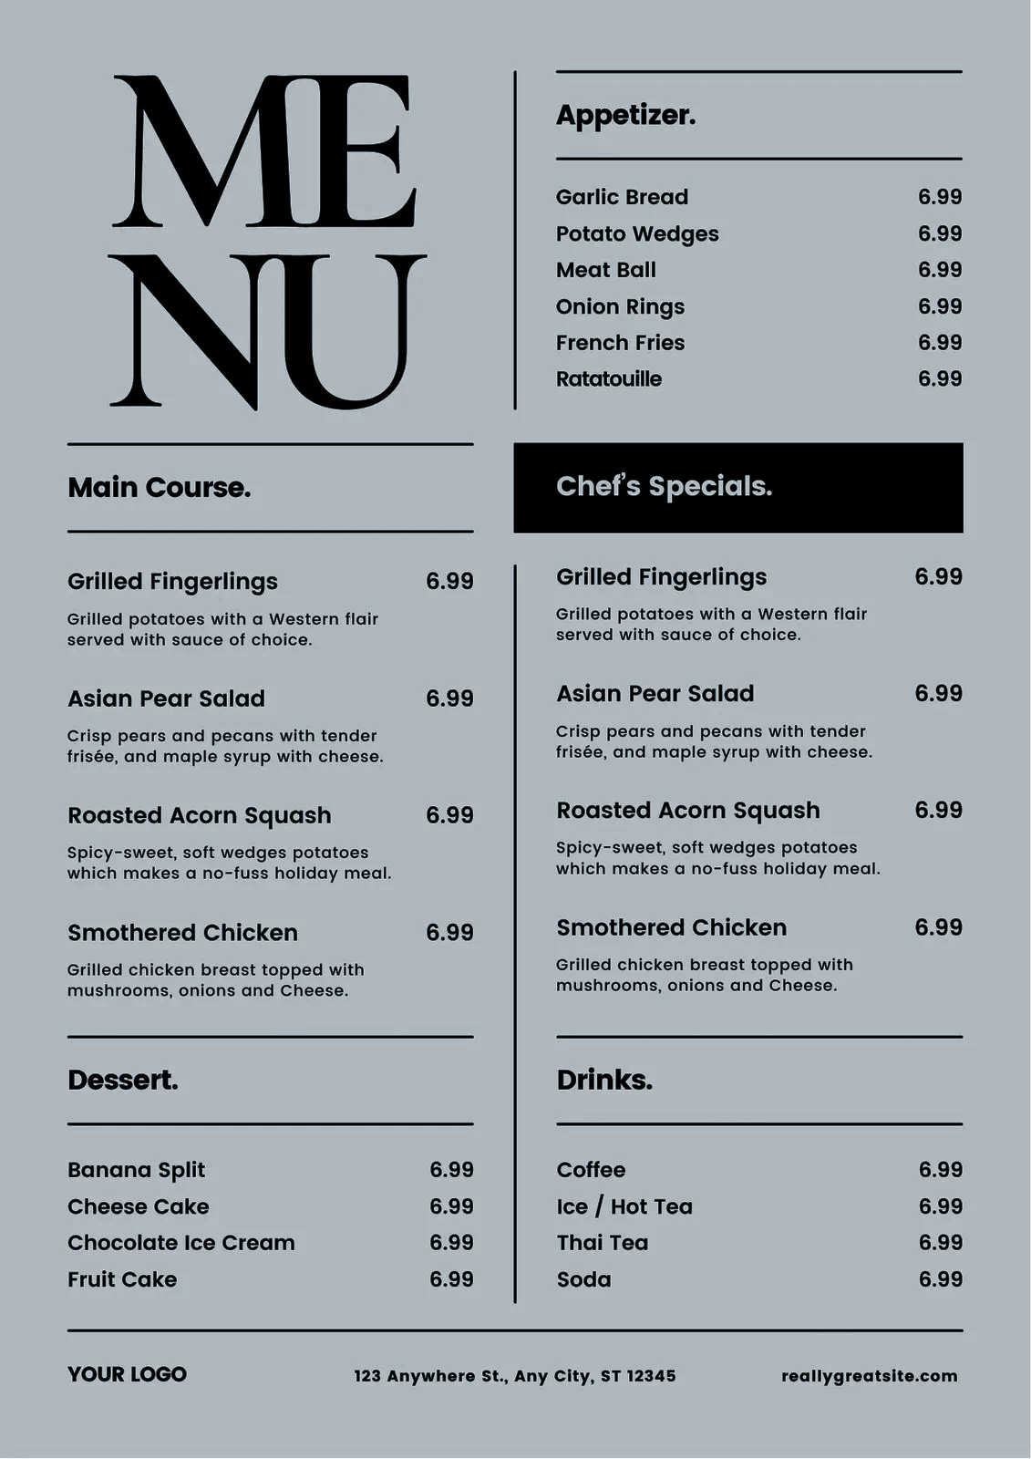
Restaurant Application
My Idea
Created a Database including restaurants hotspots in London and some of the menu items they serve, keeping a record of orders made by which customers and any reviews customers have left about food
Real Life Application
With small modification such as removing customer private info (phone number) can be used in app where customers can view restaurants items their cost, and customers review about food before choosing a place to eat, as well as being able to order from here as well. This would require me to include all menu items and prices from all restaurants, hide private customer information from other users and include more reviews.
Further Development
Would include more popular restaurants located in different cities,and more menu items for each restaurant

Slide 2
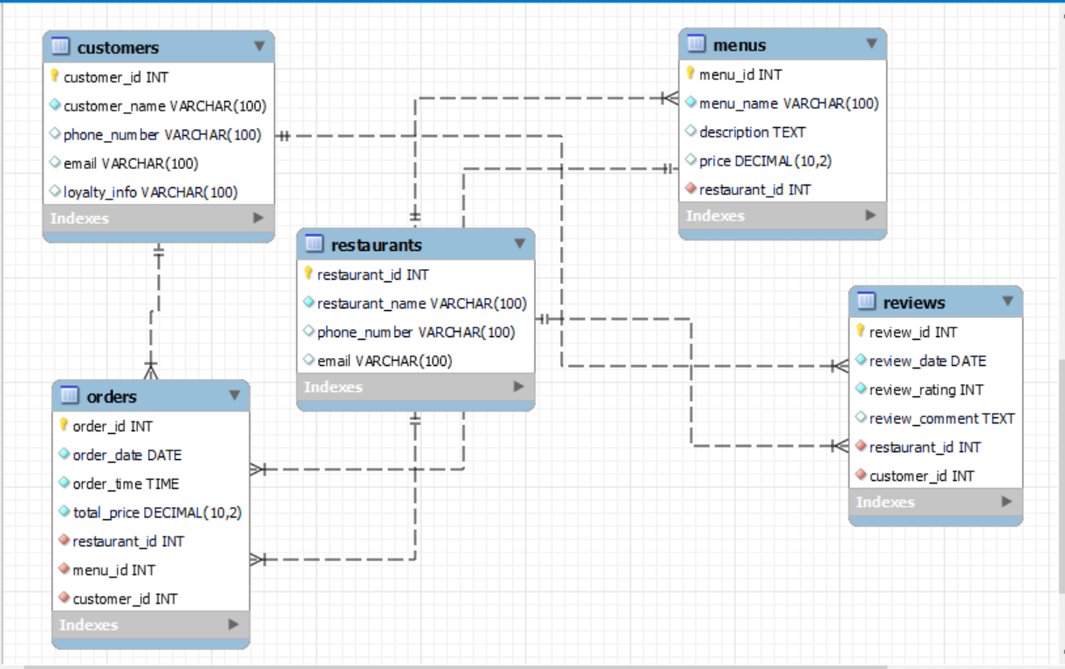
Customers - Includes customers name phone number,email address and their loyalty info (based of how frequently they order
Orders - Include time and date order made,total price and foreign keys linking to 3 different tables
Restaurant - includes restaurant name,their phone number and email
Menus - includes menu items for restaurants, a description of the item and how much it cost
Review - includes date review made, rating out ot 5 comment left if any,also includes foreign keys so you can see which customer left review and for which restaurant.

Slide 3
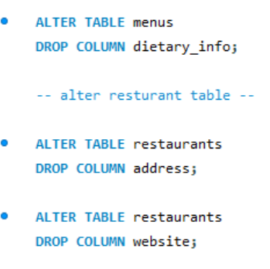
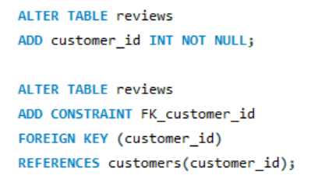
Point to consider
Alteration of tables
when coming up with columns i wanted to include,may have been too ambitious - decided to drop columns that didnt seem necessary, or were just too time consuming to find information on
Dropped dietary info as not many menu items included, if making bigger database something to factor in
Alter restaurant table - in hindsight address should’ve been left in to see location of restaurant on app. Website column was not deemed necessary as if carried out on larger scale all menu items would be present on app.
Addition of foreign keys
Had to be strategic with where i added these for database to all come together. Here I forgot to add customer id foreign key. I wanted to be able to see which customer had left what review

Slide 4
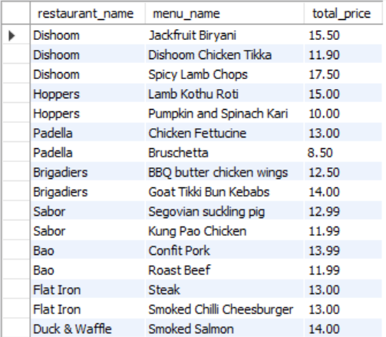
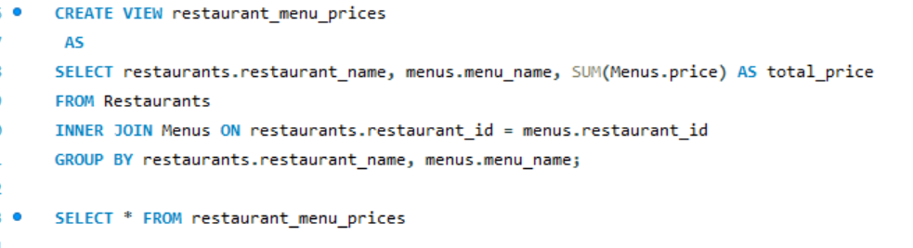
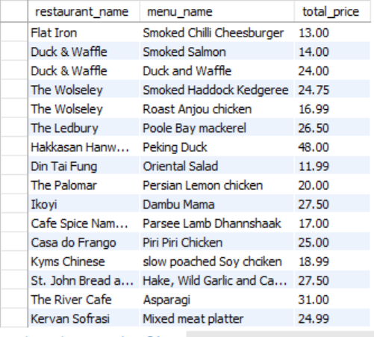
Inner Join To combine Table
Inner join used to combine restaurant and menu tables and grouping results by restaurant name and menu item name
From image on right you can see it display the names of all restaurants and their menu items with total price for each menu item

Slide 5
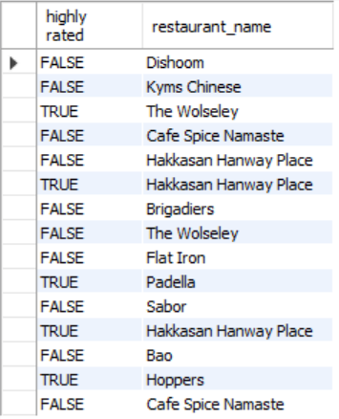
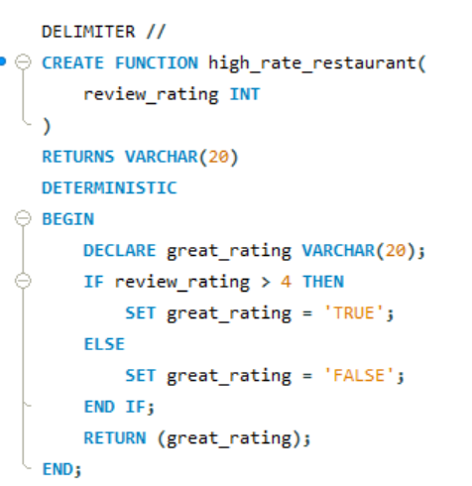
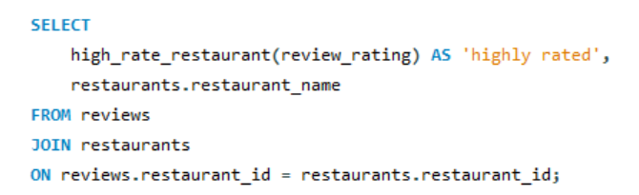
Created stored function
This function returns the row ‘highly rated’ by returning TRUE value for restaurants with rating 4 and above and false for any restaurants 3 and above
We then execute a select statement thats calls function;
SELECT high_rate_restaurant
This returns high rated restaurant with TRUE value
From this we can see from review lefts, The Wolseley, Hakkasan, Padella and Hoppers received 4* and above reviews

Slide 6
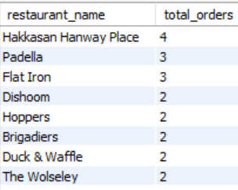
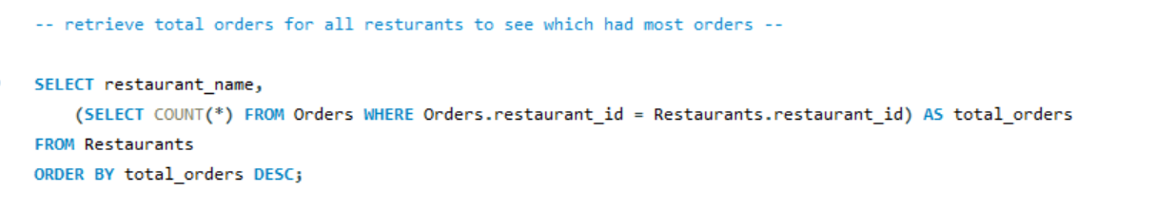
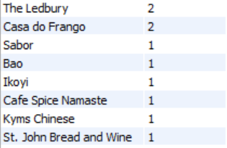
Query and Subquery to find total number of orders for each Restaurant
Here, the subquery calculates the total number of orders for each restaurant by counting the number of orders with matching restaurant id in orders table. The main query selects restaurant name and total orders for each restaurant. The results are then ordered in descending order so we can see which restaurant received most orders .
Hakkasan Hanway place received most orders

Slide 7
Reflection
What was good
Include variety of restaurants and menu items and customers
Learn how to build quite detailed database; more similar to real life application
Good use of primary and foreign keys to combine all databases together
To improve
Include more menu items for each restaurant - some restaurants only had one menu item
Use more queries to analyse data. Example include finding total revenue restaurants made from orders received, grouping restaurants based on reviews.

